Slide 1
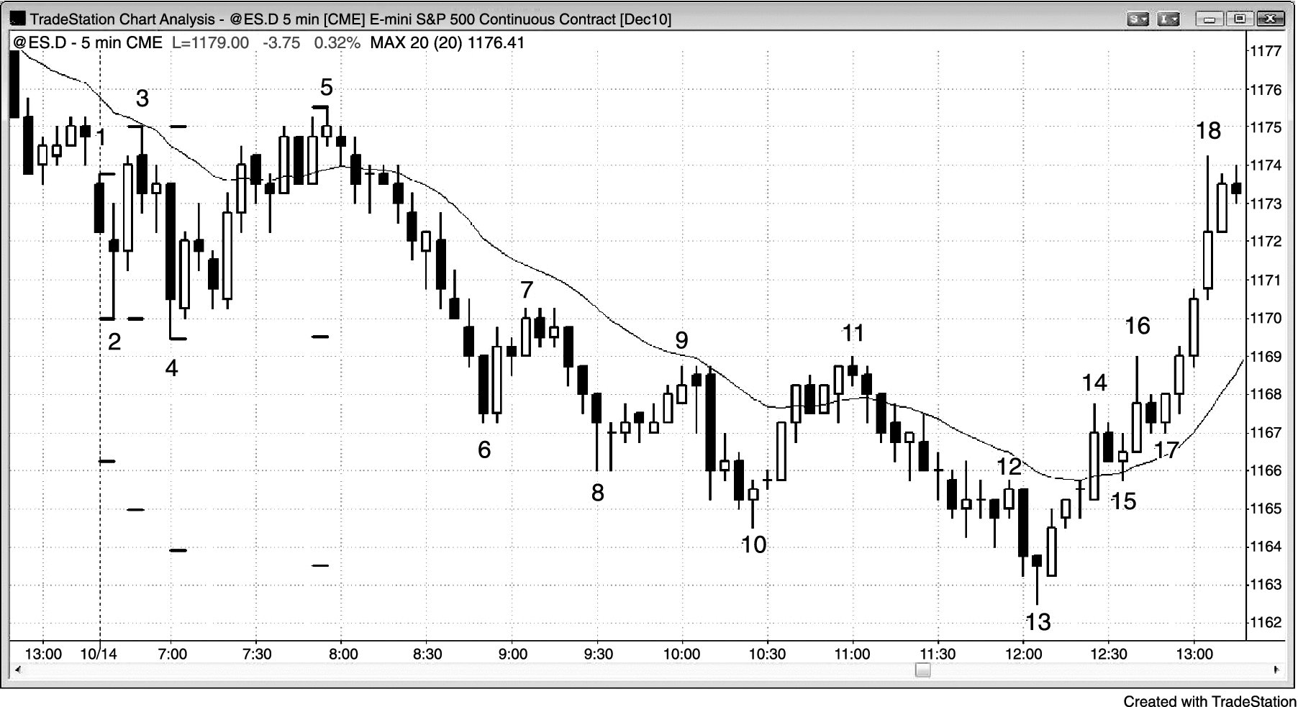
FIGURE 19.1 Measured Move after Breakout of Small Opening Range

Slide 2
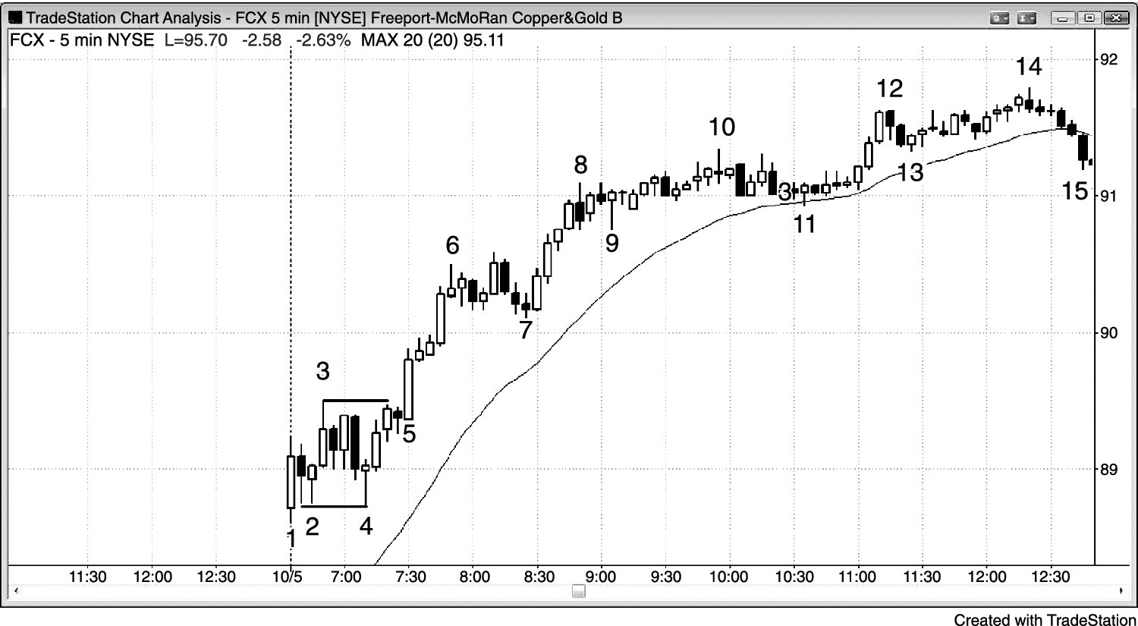
FIGURE 19.2 The Size of the Opening Range Is Important

Slide 3
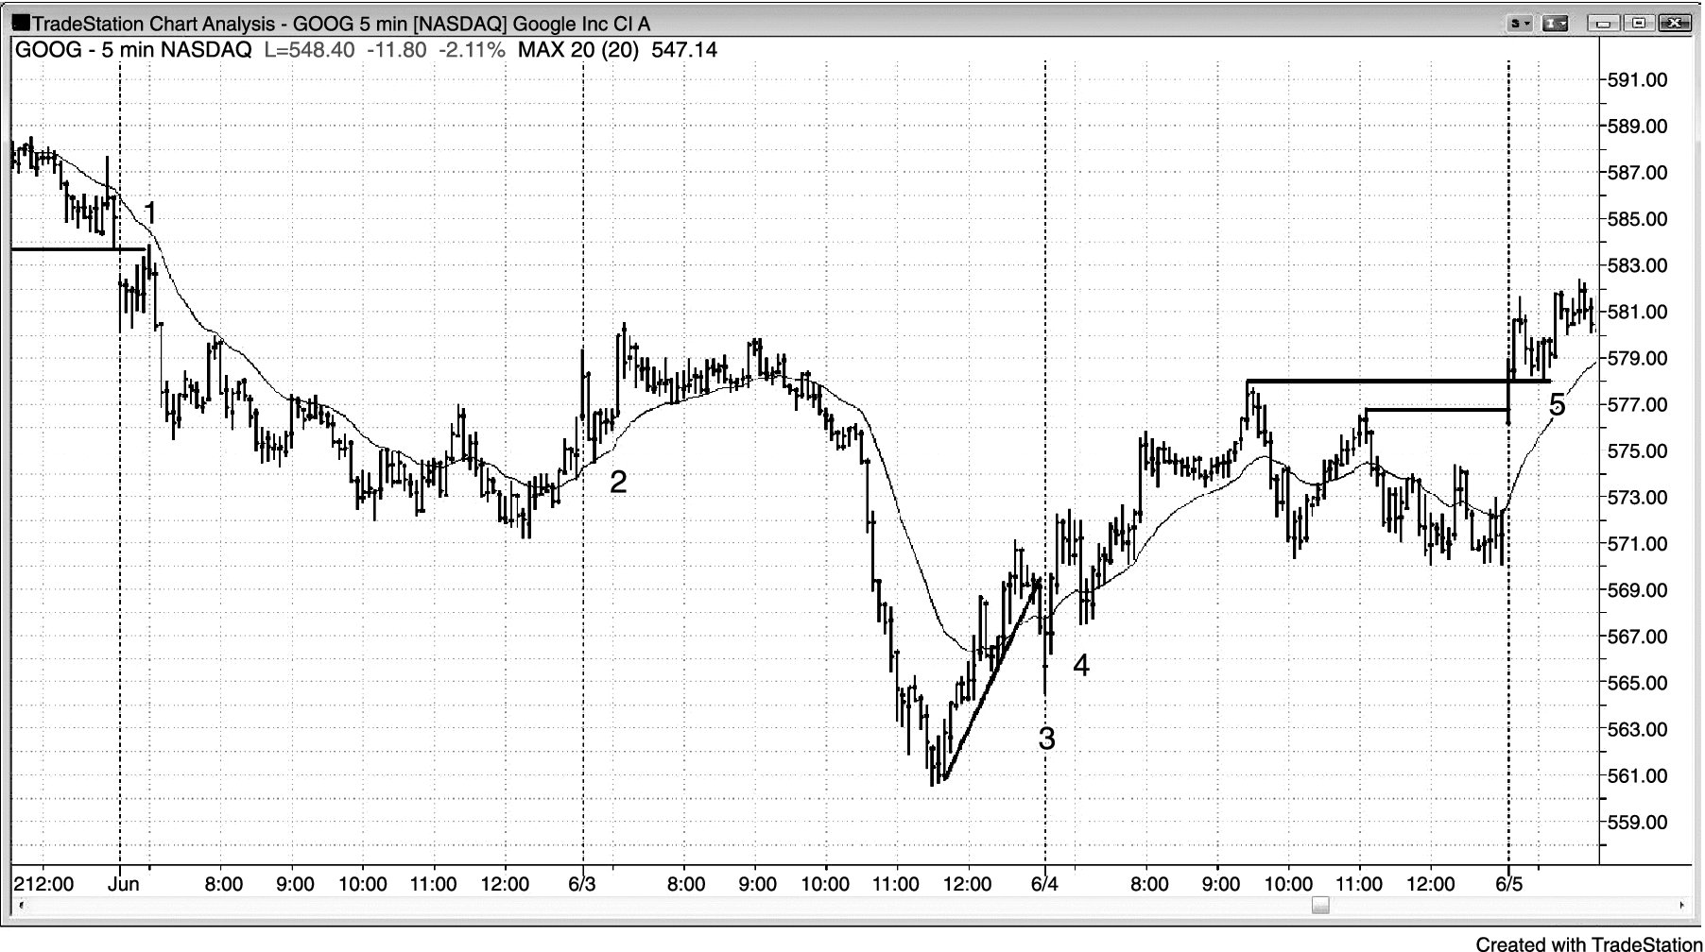
FIGURE 19.3 Breakout Pullbacks on the Open

Slide 4
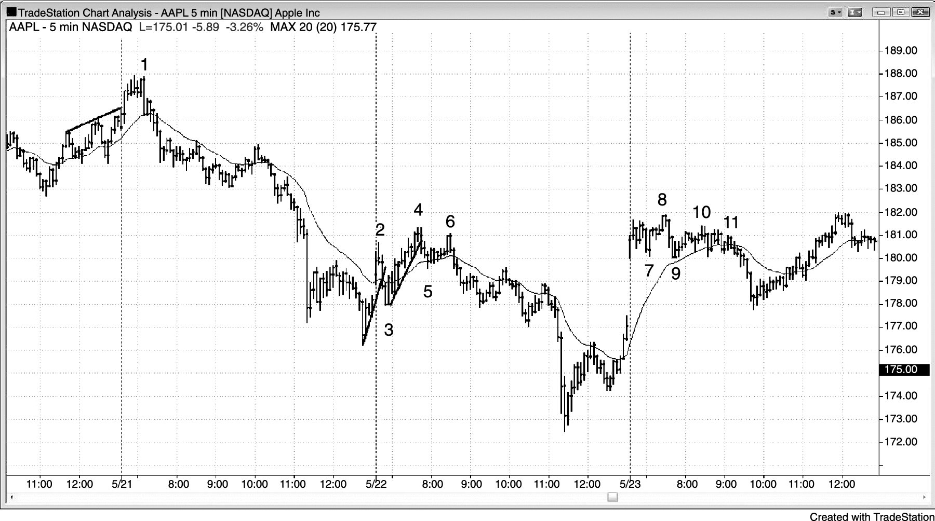
FIGURE 19.4 Early Failed Breakouts

Slide 5
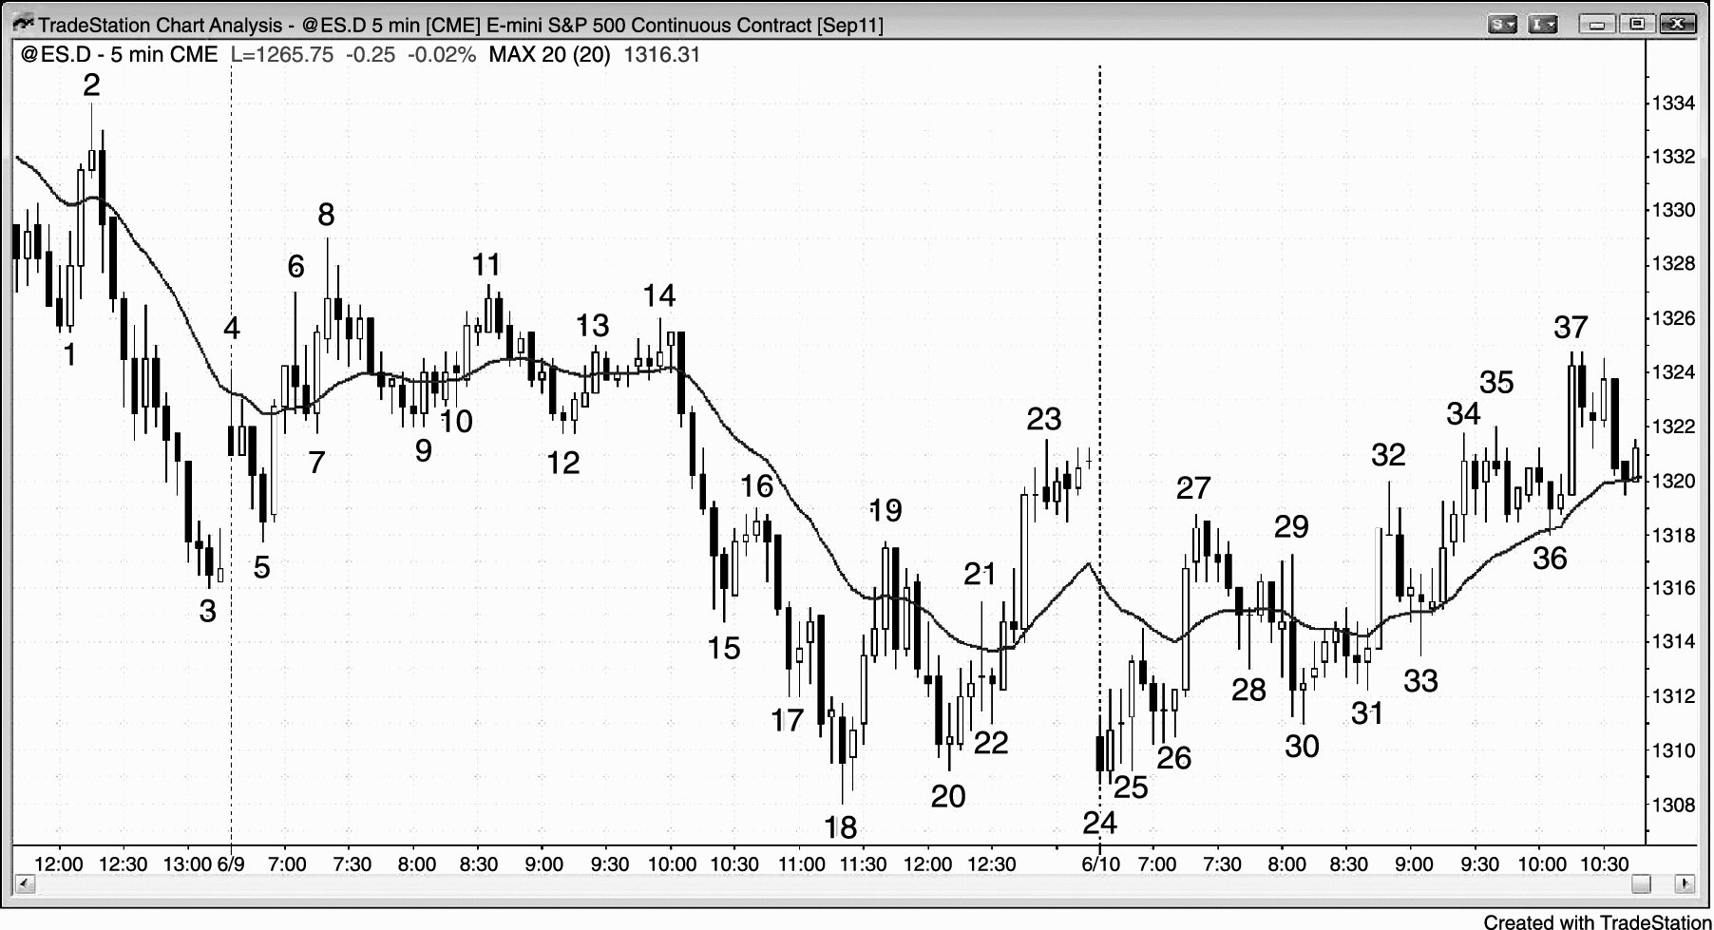
FIGURE 19.5 Both a Gap Down and a Gap Up Can Lead to an Opening Rally

Slide 6
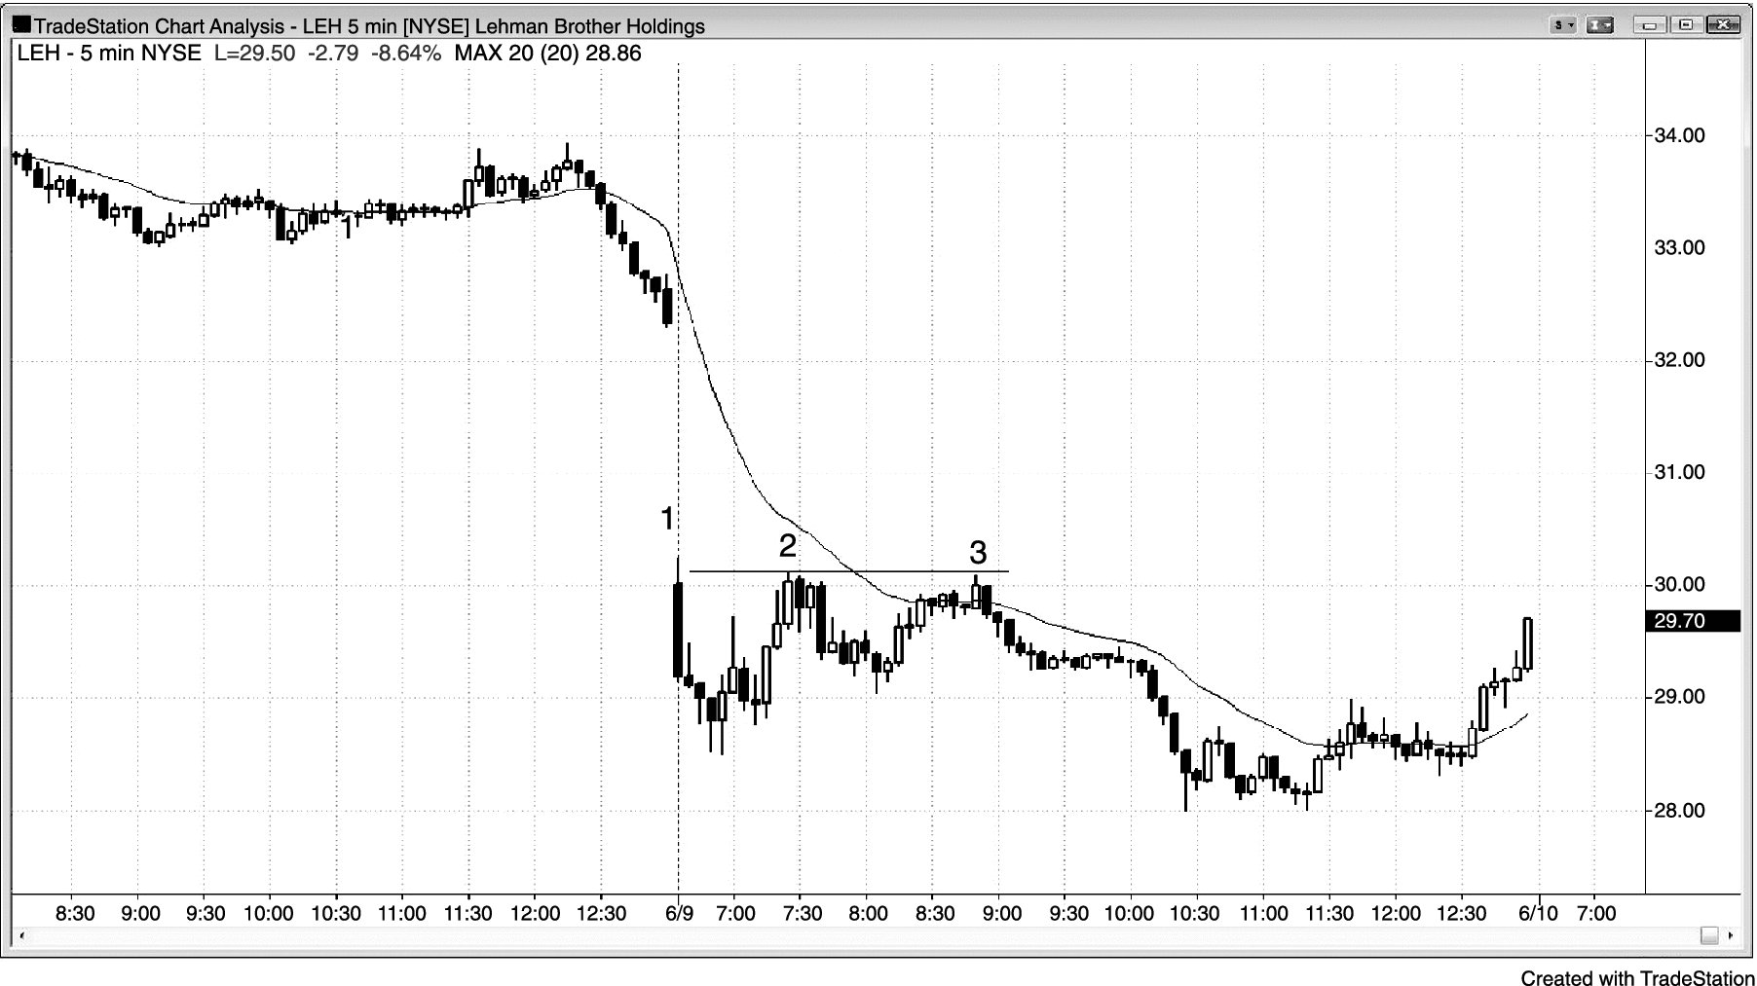
FIGURE 19.6 Two-Legged Pullback after Gap Opening

Slide 7
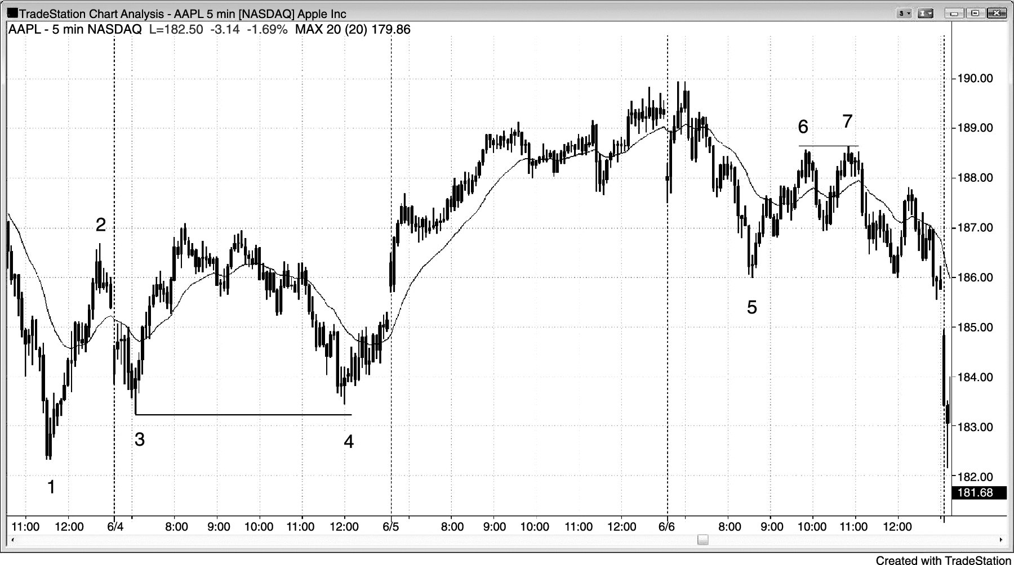
FIGURE 19.7 Double Bottom and Top Flags

Slide 8
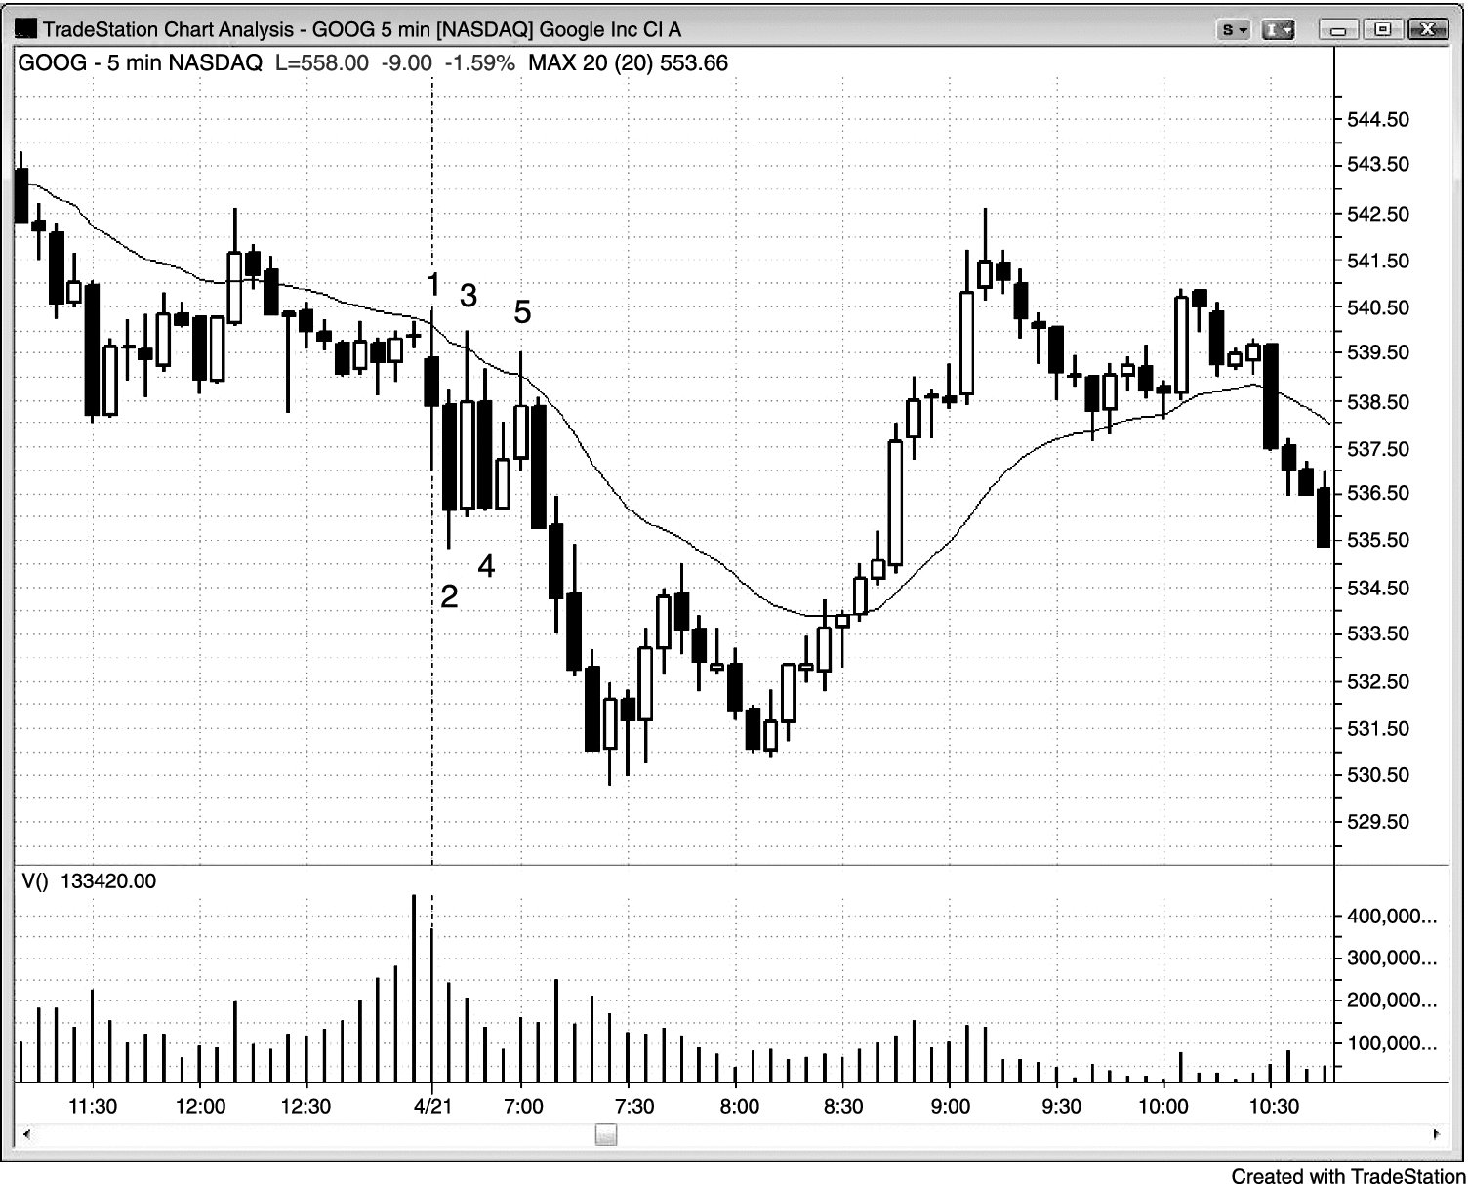
FIGURE 19.8 Two Failed Attempts and Then a Reversal

Slide 9
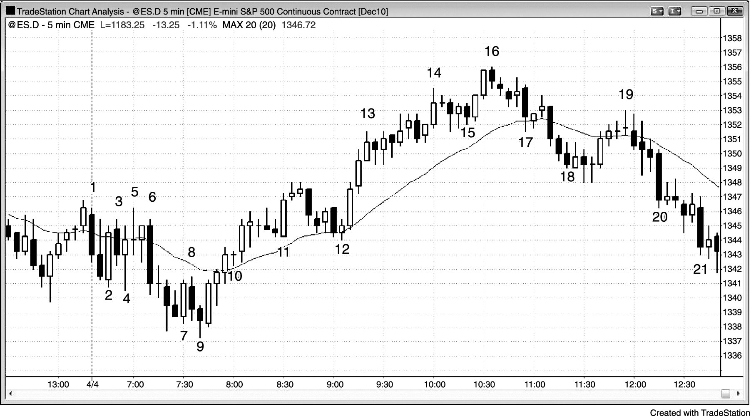
FIGURE 19.9 Barbwire on the Open

